Slide 1
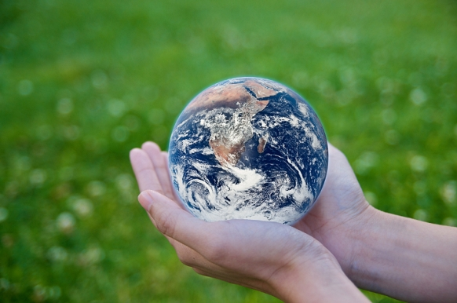
Our Certain Future
Ecclesiastes 9:1-10
Dr. Rick Griffith • Crossroads International Church Singapore
CICFamily.com • BibleStudyDownloads.org

Slide 2
The Future
UNCERTAIN
Website

Slide 3
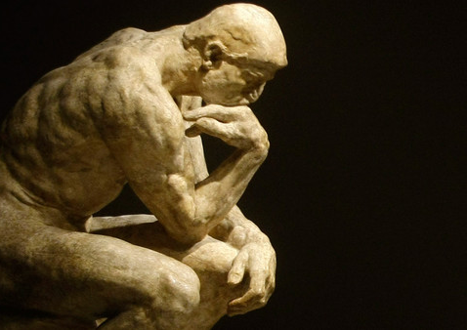
How do most people deal with our uncertain future?
Materialism
Hedonism
Humanism
Fatalism

Slide 4
How should we respond to an uncertain future?
Ecclesiastes 9:1-10
Our Reality (1-6)
Our Response (7-10)
Notes:
Transition: Solomon first tells us the reality that we all face...

Slide 5
I. Your uncertain future includes certain death (9:1-6).
Notes:
You know nothing of what will happen to you except that you will die!

Slide 6
"So I reflected on all this and concluded that the righteous and the wise and what they do are in God's hands, but no man knows whether love or hate awaits him" (9:1 NIV84).
Notes:
Even godly and wise people don't know if God will allow others to love or hate them (9:1).

Slide 7
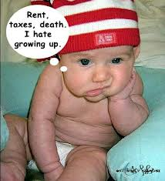
Bummer of a message?
Rent, taxes, death. I hate growing up.

Slide 8
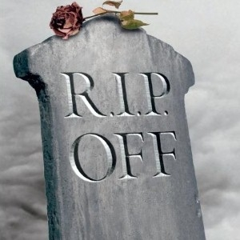
No one will escape death, the common fate for all (9:2-3).

Slide 9
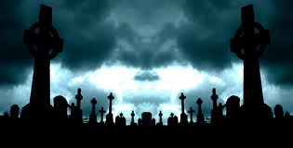
"The same destiny ultimately awaits everyone, whether righteous or wicked, good or bad, ceremonially clean or unclean, religious or irreligious. Good people receive the same treatment as sinners, and people who make promises to God are treated like people who don't" (9:2 NLT).
Notes:
No matter what kind of life we live, we'll still die (9:2).

Slide 10
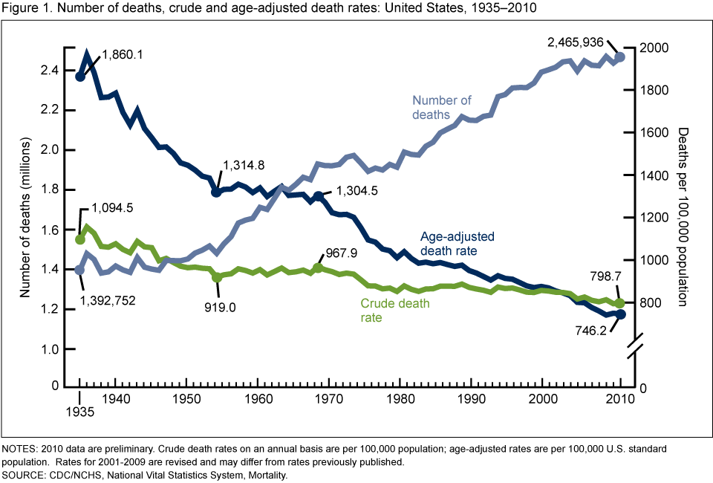
75 Years of Mortality in the United States, 1935–2010
Centers for Disease Control and Prevention (cdc.gov)
Notes:
Although the number of deaths increased over the 75 years, the risk of dying decreased
NCHS Data Brief
Number 88, March 2012
Donna L. Hoyert, Ph.D.
http://www.cdc.gov/nchs/data/databriefs/db88.htm

Slide 11
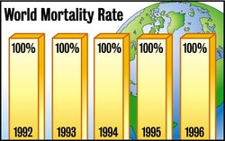
Death Rate 1992-1996
World Mortality Rate
Notes:
The Onion: America's Finest News Source, reports…
GENEVA, SWITZERLAND—World Health Organization officials expressed disappointment Monday at the group's finding that, despite the enormous efforts of doctors, rescue workers and other medical professionals worldwide, the global death rate remains constant at 100 percent.
Death, a metabolic affliction causing total shutdown of all life functions, has long been considered humanity's number one health concern. Responsible for 100 percent of all recorded fatalities worldwide, the condition has no cure.
"I was really hoping, what with all those new radiology treatments, rescue helicopters, aerobics TV shows and what have you, that we might at least make a dent in it this year," WHO Director General Dr. Gernst Bladt said. "Unfortunately, it would appear that the death rate remains constant and total, as it has inviolably since the dawn of time."
News • survival • ISSUE 31•02 • Jan 22, 1997
http://www.theonion.com/articles/world-death-rate-holding-steady-at-100-percent,1670/

Slide 12
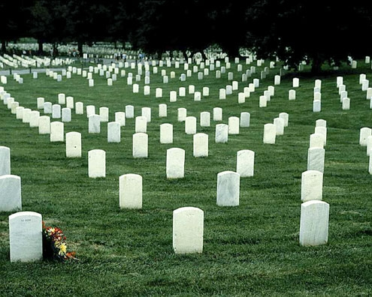
“World Death Rate Holding Steady At 100 Percent”
Notes:
The Onion continues in this article entitled “World Death Rate Holding Steady At 100 Percent”…
“Many are suggesting that the high mortality rate represents a massive failure on the part of the planet's health care workers.
"The inability of doctors and scientists to adequately address this issue of death is nothing less than a scandal," concerned parent Marcia Gretto said. "Do you have any idea what a full-blown case of death looks like? Well, I do, and believe me, it's not pretty. In prolonged cases, total decomposition of the corpse is the result."
"What about the children?" the visibly moved Gretto added.
"At this early date, I don't want to start making broad generalizations," Citizens for Safety's Robert Hemmlin said, "but it is beginning to seem possible that birth—as well as the subsequent life cycle that follows it—may be a serious safety risk for all those involved."
Death, experts say, affects not only the dead, but the non-dead as well.”
News • survival • ISSUE 31•02 • Jan 22, 1997
http://www.theonion.com/articles/world-death-rate-holding-steady-at-100-percent,1670/

Slide 13
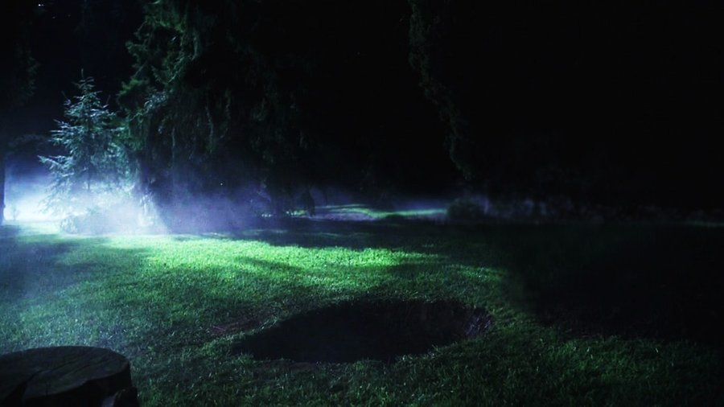
"It seems so tragic that everyone under the sun suffers the same fate. That is why people are not more careful to be good. Instead, they choose their own mad course, for they have no hope. There is nothing ahead but death anyway" (9:3 NLT).
Notes:
The unfortunate part of this common destiny is that it causes people to sin terribly in their madness (9:3).

Slide 14
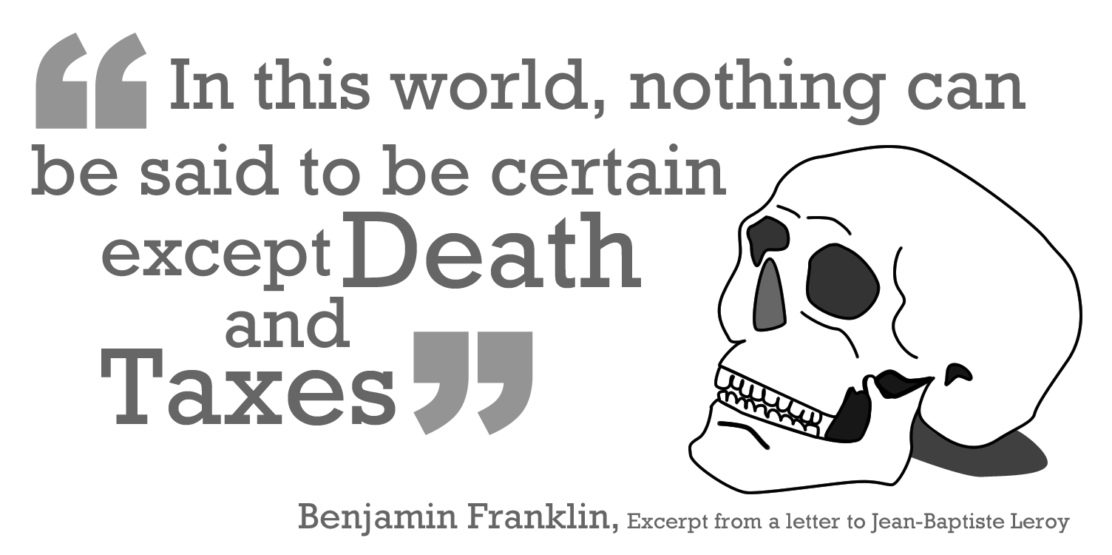
Famous Ben Franklin Quote

Slide 15
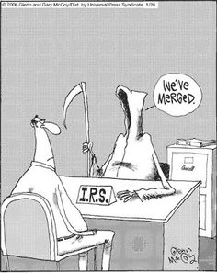
We've merged

Slide 16
Death Tax

Slide 17
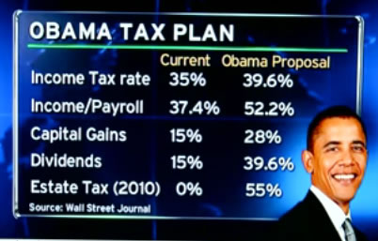
Obama Tax Plan

Slide 18
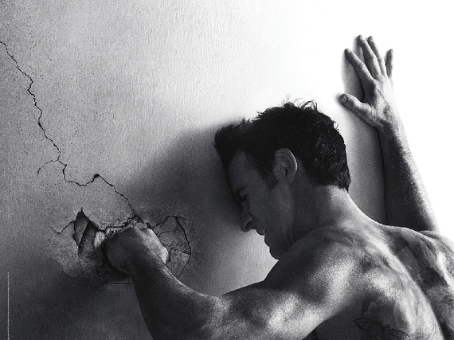
Despair
Notes:
The Brilliant Nihilism of The Leftovers - The Atlanticwww.theatlantic.com570 × 427Search by imageThe Brilliant Nihilism of The Leftovers

Slide 19
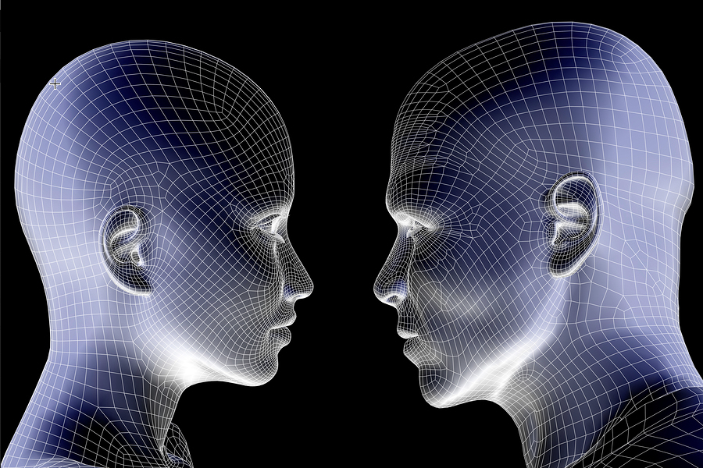
Life is still better than death (9:4-6).

Slide 20
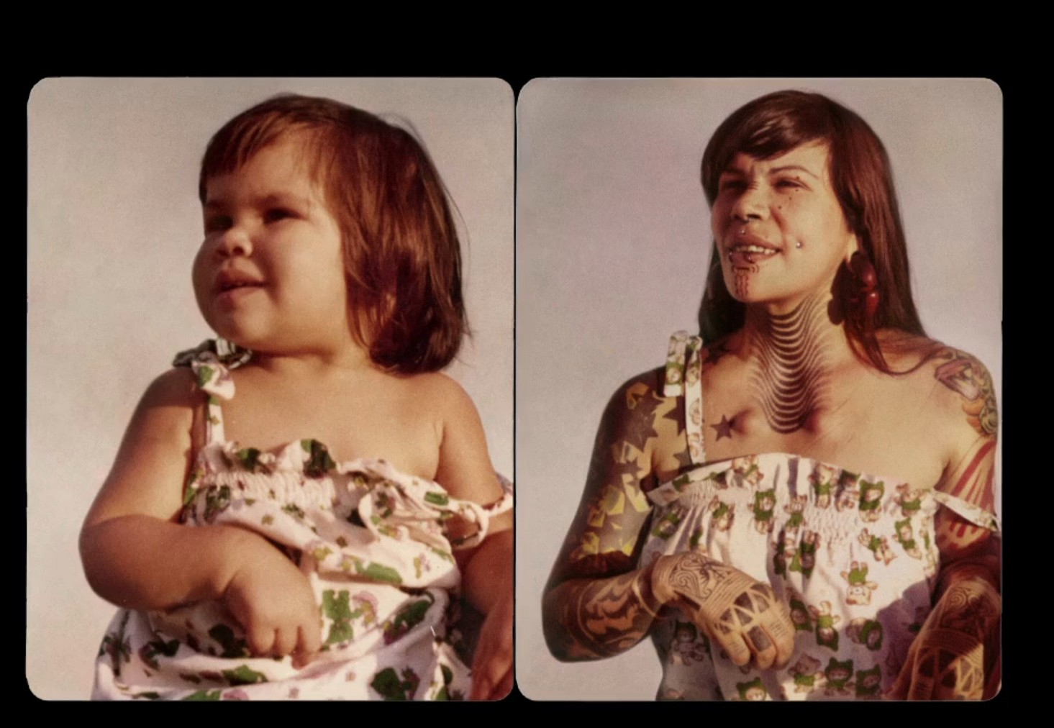
People alive have hope for future enjoyment on earth (9:4-5a)
Notes:
We may not make all the right decisions, but at least we are still alive!

Slide 21
"There is hope only for the living. As they say, 'It's better to be a live dog than a dead lion!'" (9:4 NLT).

Slide 22
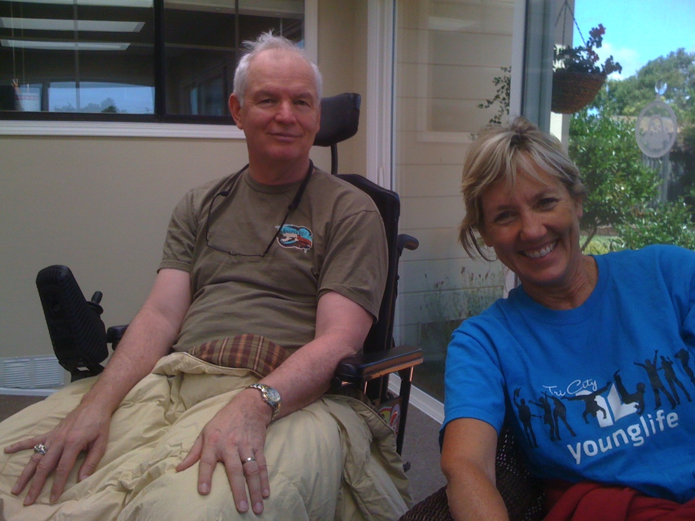
Dan & Marcia West

Slide 23
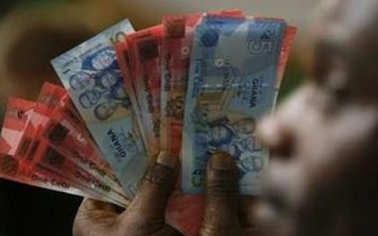
"There is another serious tragedy I have seen under the sun, and it weighs heavily on humanity. ²God gives some people great wealth and honor and everything they could ever want, but then he doesn't give them the chance to enjoy these things. They die, and someone else, even a stranger, ends up enjoying their wealth! This is meaningless—a sickening tragedy" (6:1-2 NLT).

Slide 24
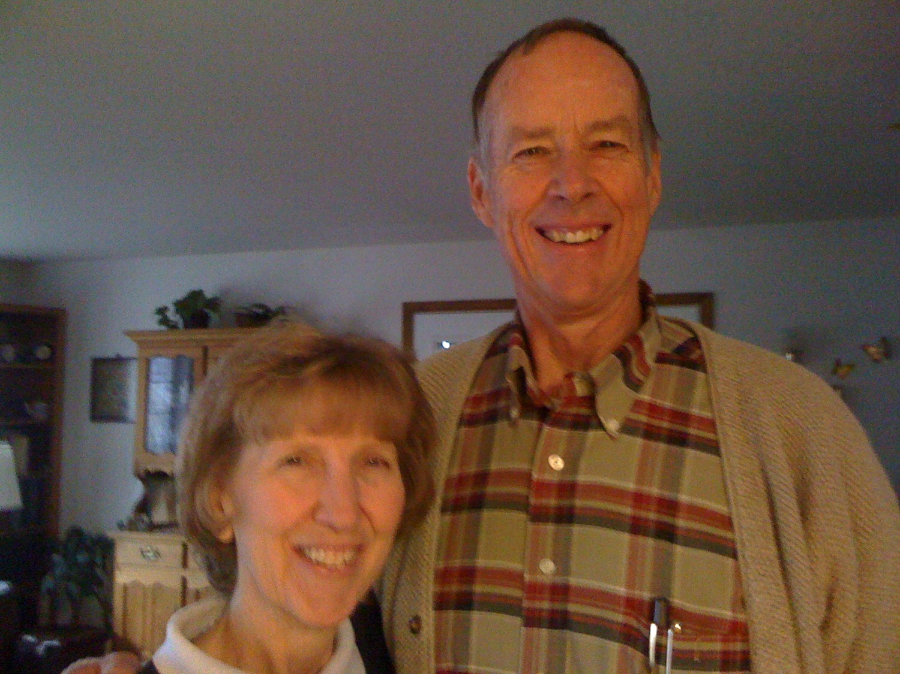
Ben & Barb Cornelius

Slide 25
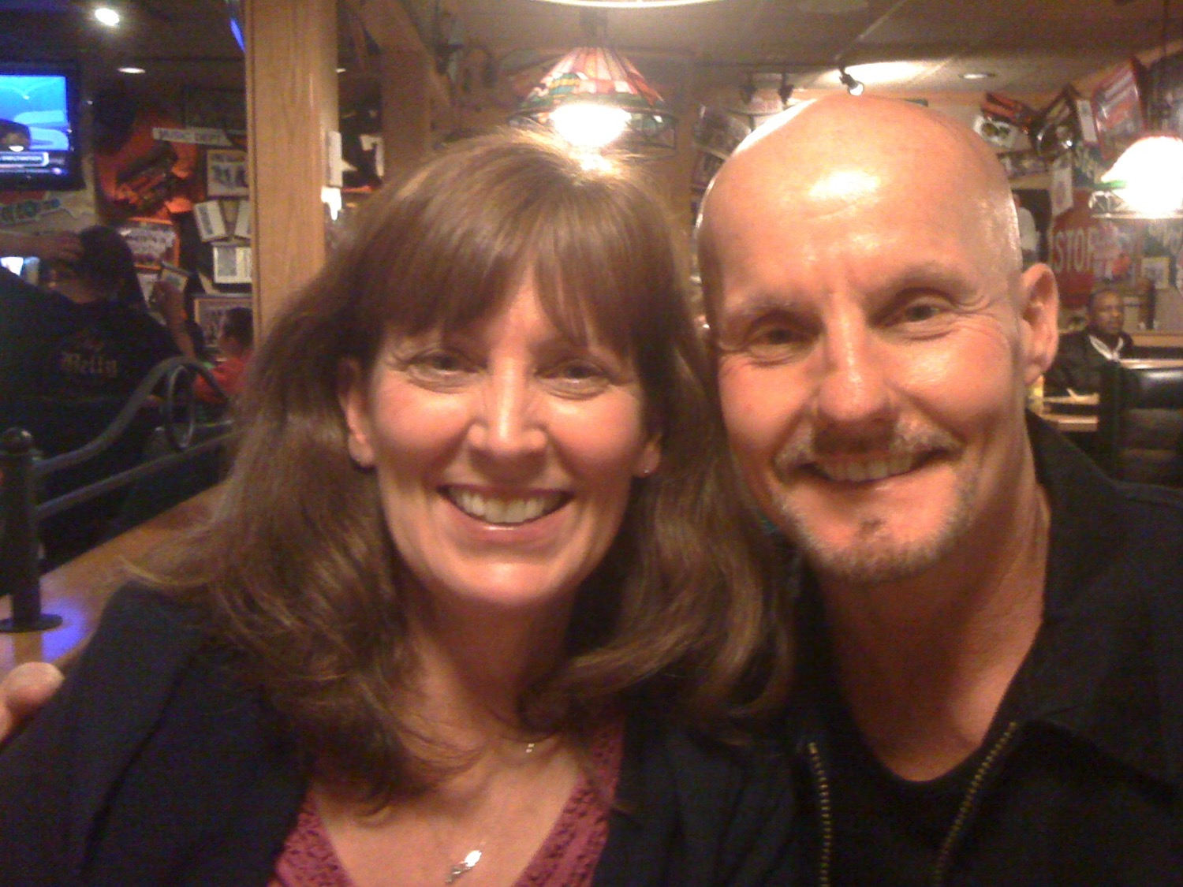
Randy & Janise Eoff

Slide 26
"The living at least know they will die, but the dead know nothing" (9:5 NLT).

Slide 27
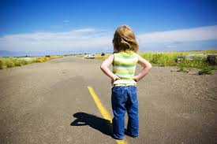
”[The dead] have no further reward, nor are they remembered. ⁶Whatever they did in their lifetime—loving, hating, envying—is all long gone. They no longer play a part in anything here on earth" (9:6 NLT).

Slide 28
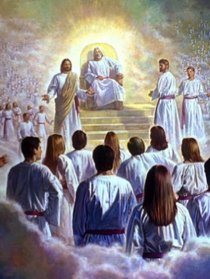
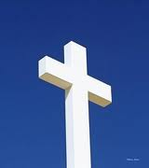
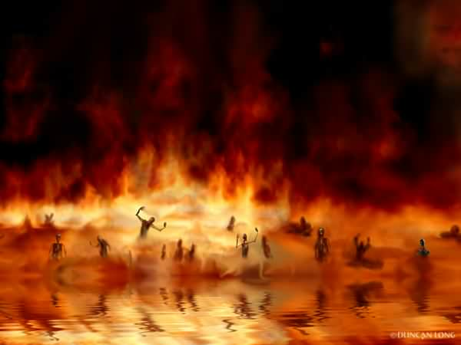
The Transfer of Paradise
"That is why the Scriptures say, 'When he ascended to the heights, he led a crowd of captives and gave gifts to his people.' ⁹Notice that it says 'he ascended.' This clearly means that Christ also descended to our lowly world. ¹⁰And the same one who descended is the one who ascended higher than all the heavens, so that he might fill the entire universe with himself."
14 & 16
NLT
HEAVEN
Eph. 4:8-10
"…today you will be with me in paradise."
"I was caught up to the third heaven…I was caught up to paradise"
Luke 23:43
2 Cor. 12:2-4
S H E O L
"Christ suffered for our sins once for all time. He never sinned, but he died for sinners to bring you safely home to God. He suffered physical death, but he was raised to life in the Spirit.
¹⁹So he went and preached to the spirits in prison— ²⁰those who disobeyed God long ago when God waited patiently while Noah was building his boat. Only eight people were saved from drowning in that terrible flood."
Paradise
HADES
1 Pet. 3:18-20
HADES
Rev. 20:14-15
Luke 16:26
Hell
Gehenna
Lake of Fire
Lake of Burning Sulfur
Second Death
"…there is a great chasm separating us. No one can cross over to you from here, and no one can cross over to us from there."
"Then death and [Hades] were thrown into the lake of fire... ¹⁵And anyone whose name was not found recorded in the Book of Life was thrown into the lake of fire."

Slide 29
I. Your uncertain future includes certain death (9:1-6).
Notes:
You know nothing of what will happen to you except that you will die!

Slide 30
II. Since you'll die, enjoy life and work hard now (9:7-10).

Slide 31
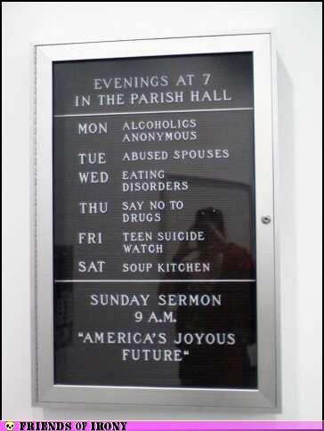
Enjoy life as God enables (9:7-9).
Notes:
Enjoy life as God enables (9:7-9).

Slide 32
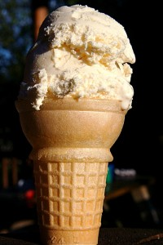
"So go ahead. Eat your food with joy, and drink your wine with a happy heart, for God approves of this!" (9:7 NLT).
Notes:
Enjoy life as God enables (9:7-9).

Slide 33
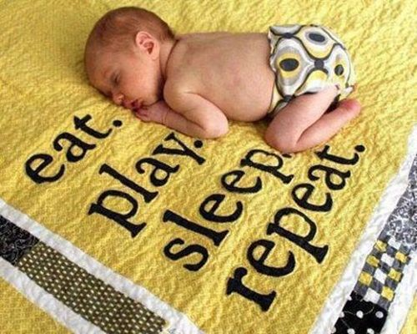
Babies Enjoy Life!

Slide 34
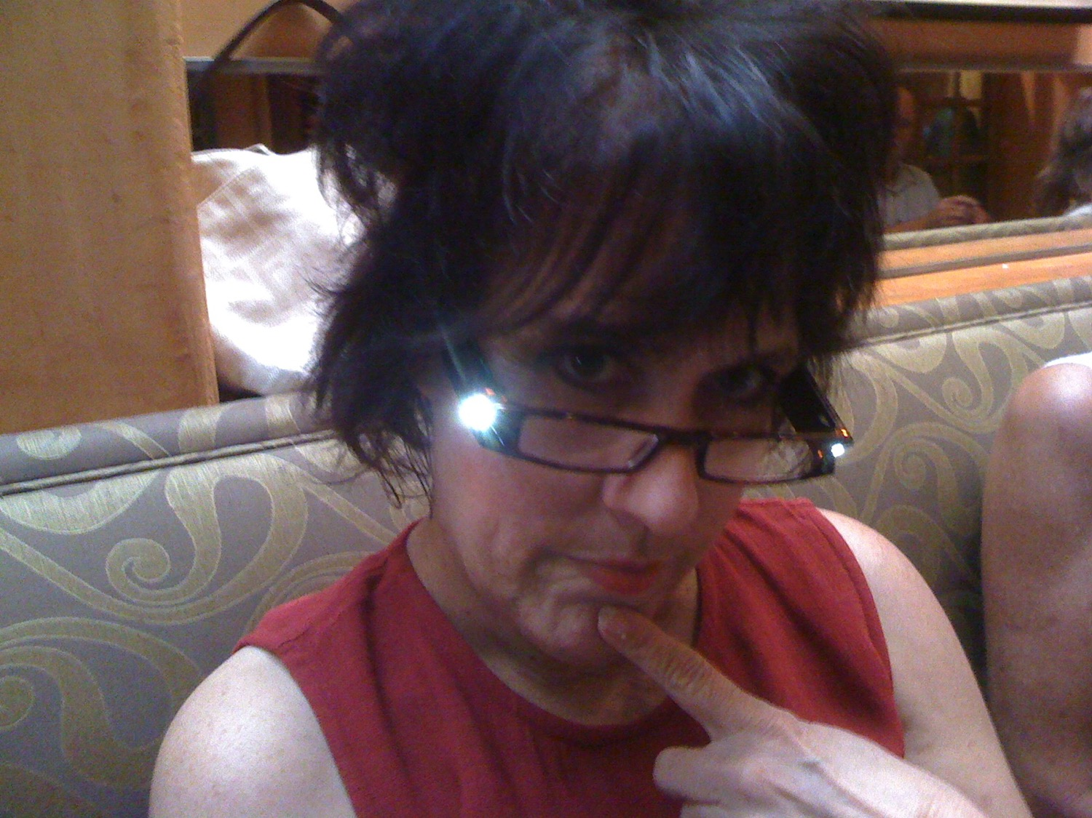
Pepper Pierson

Slide 35
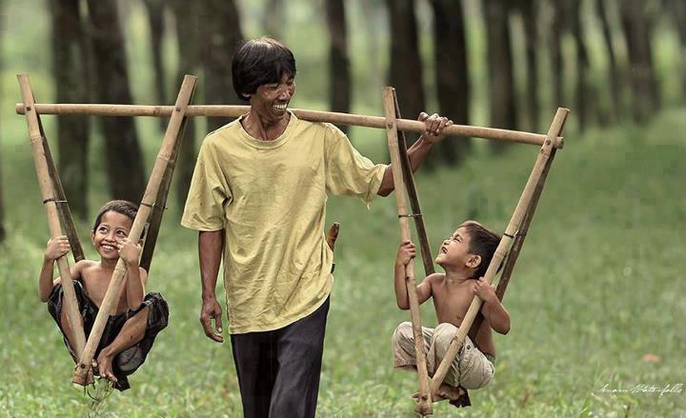
"Even so, I have noticed one thing, at least, that is good. It is good for people to eat, drink, and enjoy their work under the sun
during the short life God has given them, and to accept their lot in life" (5:18 NLT).

Slide 36
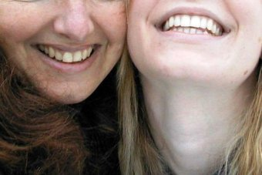
"And it is a good thing to receive wealth from God and the good health to enjoy it. To enjoy your work and accept your lot in life—this is indeed a gift from God" (5:19 NLT).

Slide 37
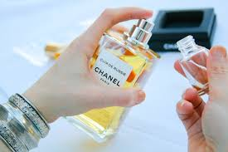
”Wear fine clothes, with a splash of cologne!" (9:8 NLT).

Slide 38
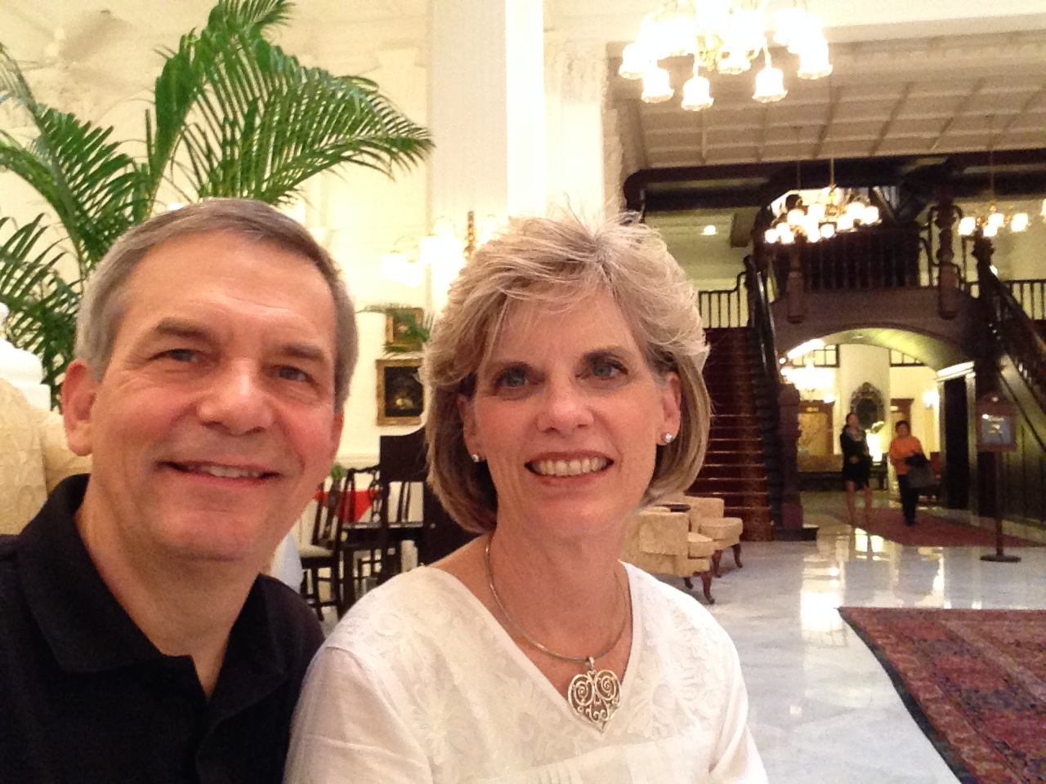
"Enjoy life with your wife, whom you love, all the days of this meaningless life that God has given you under the sun —all your meaningless days" (9:9a NIV).

Slide 39
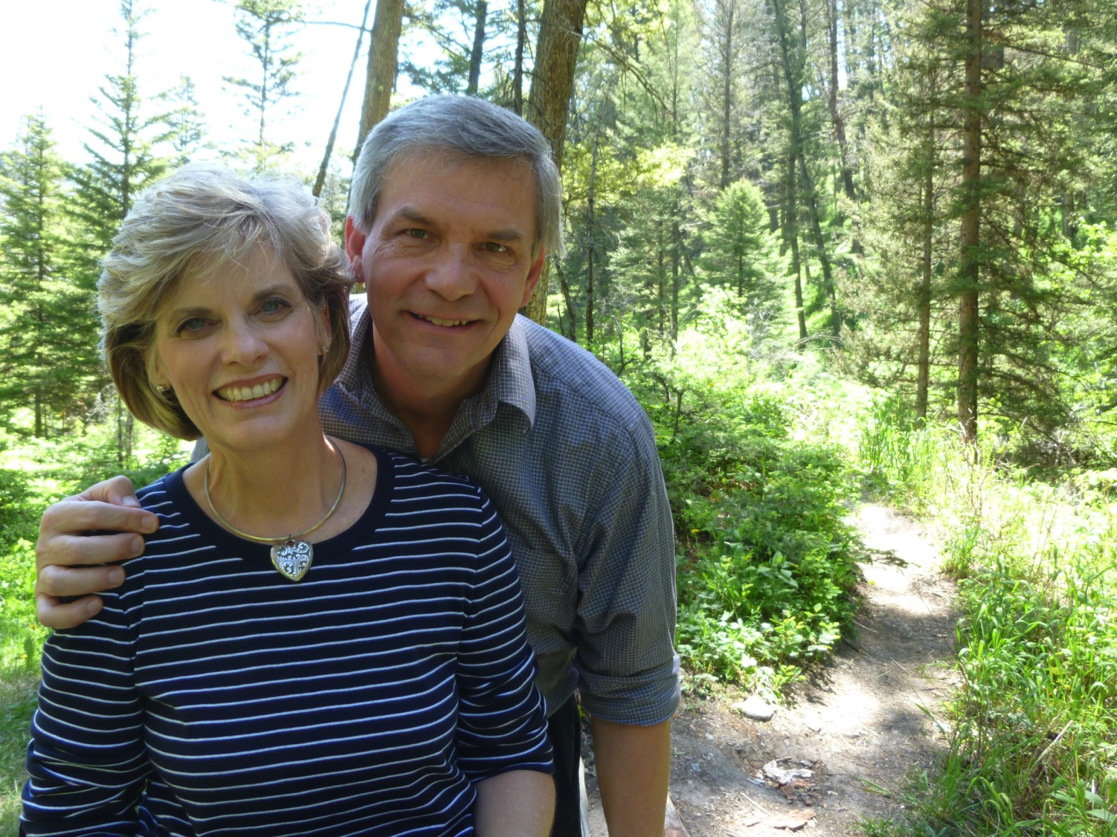
“The wife God gives you is your reward for all your earthly toil" (9:9b NLT).

Slide 40
Work hard while you can (9:10)

Slide 41
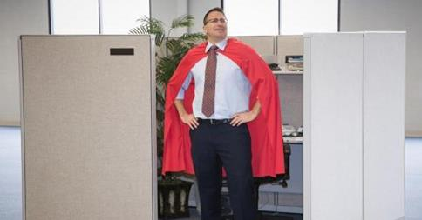
"Whatever you do, do well. For when you go to the grave [Sheol], there will be no work or planning or knowledge or wisdom" (9:10 NLT).

Slide 42
Study hard too!

Slide 43
Main Idea of Ecclesiastes 9:1-10
Since you don't know the future, work hard and enjoy life!

Slide 44
God Holds the Future

Slide 45
I. Your uncertain future includes certain death (9:1-6).
Notes:
You know nothing of what will happen to you except that you will die!

Slide 46
II. Since you'll die, enjoy life and work hard now (9:7-10).

Slide 47
Make a goal to fight that fear
What is your fear?

Slide 48
Make your goal…
Measurable (The goal should be specific enough to be able to pinpoint whether it was achieved or not)
Realistic (The goal should be attainable in a week's time)

Slide 49
Who will you serve in your future?

Slide 50
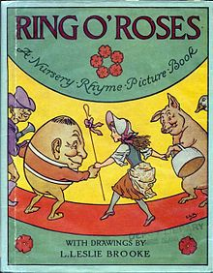
Are you ready for death?
Ring-a-round the rosie, A pocket full of posies, Ashes! Ashes!
We all fall down.

Slide 51
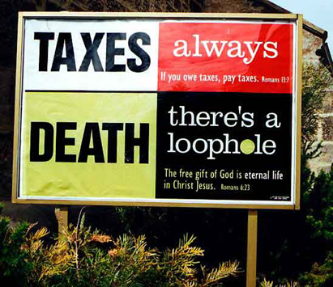
The Loophole

Slide 52
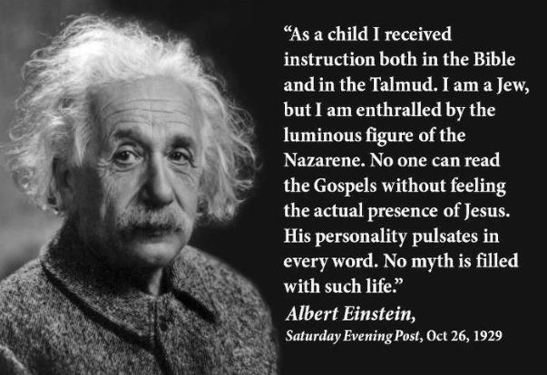
Albert Einstein on Jesus
“As a child I received instruction both in the Bible and in the Talmud. I am a Jew, but I am enthralled by the luminous figure of the Nazarene. No one can read the Gospels without feeling the actual presence of Jesus. His personality pulsates in every word. No myth is filled with such life.”
Albert Einstein Saturday Evening Post, Oct 26, 1929

Slide 53
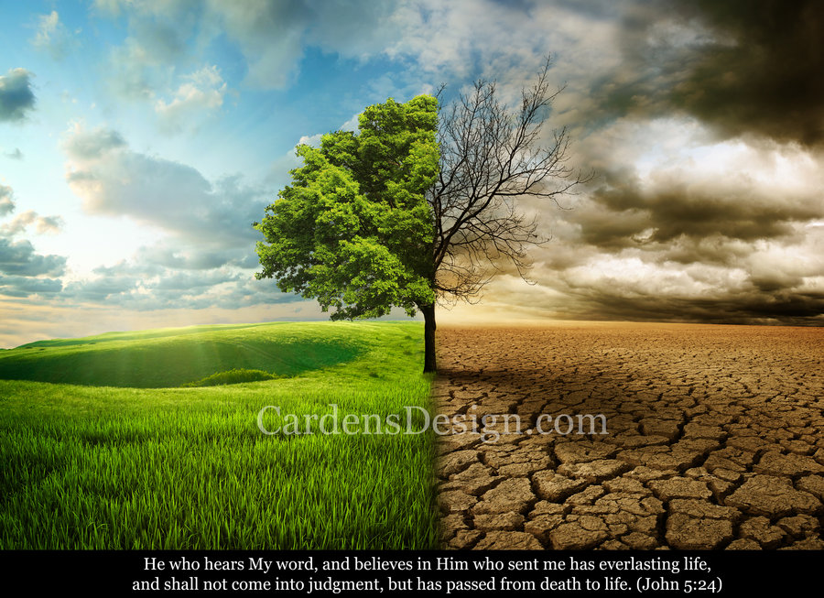
“I tell you the truth, those who listen to my message and believe in God who sent me have eternal life. They will never be condemned for their sins, but they have already passed from death into life” (John 5:24 NLT)

Slide 54
Black

Slide 55
OT Preaching link at BibleStudyDownloads.org
Get this presentation and script for free!

